Slide 1
Topics to be Covered:
Multithreading in Java
Need for multithreading
Real-time examples of multithreading
What is a thread?
Advantages of multithreading
Life cycle of a thread
How to create a thread ?
Role of Thread Scheduler
Thread execution prevention methods.
sleep() method
join() method
yield() method

Slide 2
Multithreading in Java

Slide 3

Need for Multithreading
Have you faced the following situations:
Your browser cannot skip to the next web page because it is downloading a file.
You cannot enter text into your current document until your word processor completes the task of saving the document to disk

Slide 4
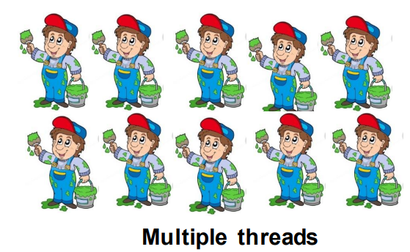

Need for Multithreading
Imagine that you need to paint your house.
You can employ one painter who will take 10 days to complete the work or you can employ 10 painters who will finish the work in one day.
In this case, the 10 painters will be painting at the same time. That is 10 threads will be executing at the same time.

Slide 5


Real-time example of Multithreading
Example 01:
Computer games are best examples of multithreading .
You might have seen that in most of the ‘race’ games, other cars or bikes will be competing with your car/bike.
These are nothing but threads
Example 02:
When you start typing in a MS Word document, you can see that the incorrectly spelled words are underlined with a red wavy line. Like:
This is done by the spell check feature of MS Word.
The spell check is running in parallel while we type in a Word document.
This is handled by a separate thread.

Slide 6
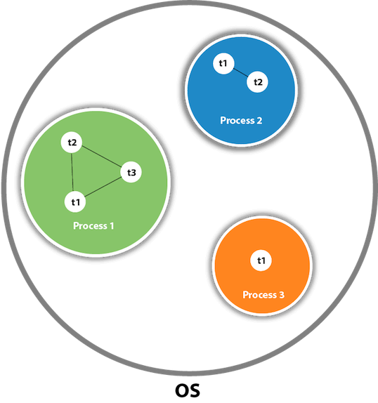
What is a thread?
A thread is a lightweight subprocess, the smallest unit of processing. It is a separate path of execution.
Threads are independent. If there occurs an exception in one thread, it doesn't affect other threads. It uses a shared memory area.

Slide 7
Advantages of multithreading
What is multithreading?
Multithreading is a process of executing multiple threads simultaneously.
What are the advantages of multithreading?
It doesn't block the user because threads are independent and you can perform multiple operations at the same time.
You can perform many operations together, so it saves time.
Threads are independent, so it doesn't affect other threads if an exception occurs in a single thread.
Note: At least one process is required for each thread.

Slide 8
Life Cycle of thread

Slide 9
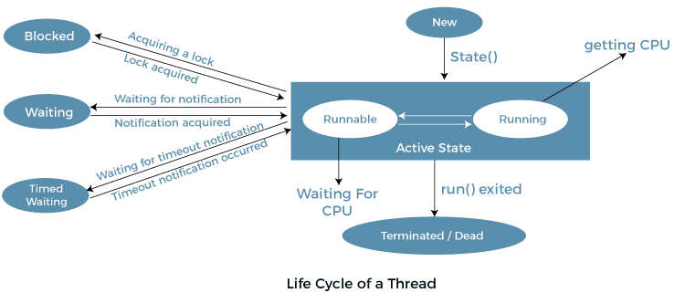
Life cycle of a Thread
In Java, a thread always exists in any one of the following states. These states are:
New
Active
Blocked / Waiting
Timed Waiting
Terminated

Slide 10
Life cycle of a Thread
New Thread:
When a new thread is created, it is in the new state.
The thread has not yet started to run when the thread is in this state.
When a thread lies in the new state, its code is yet to be run and hasn’t started to execute.
Runnable State: A thread that is ready to run is moved to a runnable state.
In this state, a thread might actually be running or it might be ready to run at any instant of time.
It is the responsibility of the thread scheduler to give the thread, time to run.
A multi-threaded program allocates a fixed amount of time to each individual thread. Each and every thread runs for a short while and then pauses and relinquishes the CPU to another thread so that other threads can get a chance to run. When this happens, all such threads that are ready to run, waiting for the CPU and the currently running thread lie in a runnable state.
Blocked/Waiting state: When a thread is temporarily inactive, then it’s in one of the following states:
Blocked
Waiting
Timed Waiting: A thread lies in a timed waiting state when it calls a method with a time-out parameter.
A thread lies in this state until the timeout is completed or until a notification is received.
For example, when a thread calls sleep or a conditional wait, it is moved to a timed waiting state.
Terminated State: A thread terminates because of either of the following reasons:
Because it exits normally. This happens when the code of the thread has been entirely executed by the program.
Because there occurred some unusual erroneous event, like a segmentation fault or an unhandled exception.

Slide 11
How to create a thread ?

Slide 12
Creating thread
There are two ways to create a thread:
By extending Thread class
By implementing Runnable interface.
Thread class:
Thread class provides constructors and methods to create and perform operations on a thread.
Thread class extends Object class and implements Runnable interface.
Commonly used Constructors of Thread class:
Thread()
Thread(String name)
Thread(Runnable r)
Thread(Runnable r, String name)
Runnable interface:
The Runnable interface should be implemented by any class whose instances are intended to be executed by a thread. Runnable interface have only one method named run().
public void run(): is used to perform action for a thread.

Slide 13
Methods of Thread Class
Method | Description
public void run() | is used to perform action for a thread.
public void start() | starts the execution of the thread.JVM calls the run() method on the thread.
public void sleep(long miliseconds) | currently executing thread to sleep for the specified number of milliseconds.
public void join() | waits for a thread to die.
public void join(long miliseconds) | waits for a thread to die for the specified miliseconds.
public int getPriority() | returns the priority of the thread.
public int setPriority(int priority) | changes the priority of the thread.
public String getName() | returns the name of the thread.
public void setName(String name) | changes the name of the thread.
public Thread currentThread() | returns the reference of currently executing thread.
public int getId() | returns the id of the thread
public Thread.State getState() | returns the state of the thread.

Slide 14
Methods of Thread Class
Method | Description
public boolean isAlive(): | tests if the thread is alive.
public void yield(): | causes the currently executing thread object to temporarily pause and allow other threads to execute.
public void suspend() | is used to suspend the thread(depricated).
public void resume() | is used to resume the suspended thread(depricated).
public void stop() | is used to stop the thread(depricated).
public boolean isDaemon() | tests if the thread is a daemon thread.
public void setDaemon(boolean b) | marks the thread as daemon or user thread.
public void interrupt(): | interrupts the thread.
public boolean isInterrupted(): | tests if the thread has been interrupted.
public static boolean interrupted(): | tests if the current thread has been interrupted.

Slide 15
By extending Thread class : Example 01
The start() method of Thread class is used to start a newly created thread. It performs the following tasks:
A new thread starts(with new callstack).
The thread moves from New state to the Runnable state.
When the thread gets a chance to execute, its target run() method will run.
class MultiEx1 extends Thread
{
public void run()
{
System.out.println(“Thread is running");
}
public static void main(String args[]
{
MultiEx1 t1=new MultiEx1 ();
t1.start(); // will invoke run() method
}
}
Output:
Thread is running

Slide 16
By Using Thread class : Example 02
Using the Thread Class: Thread(String Name)
We can directly use the Thread class to spawn new threads using the constructors
public class MultiEx2
{
// Main method
public static void main(String argvs[])
{
// creating an object of the Thread class
Thread t= new Thread("My first thread");
// the start() method moves the thread to the active state
t.start();
// getting the thread name by invoking the getName() method
String str = t.getName();
System.out.println(str);
}
}
Output:
My first thread

Slide 17
By Using Thread class : Example 03
Using the Thread Class: Thread(Runnable r, String name)
public class MultiEx3 implements Runnable
{
public void run()
{
System.out.println("Now thread is running ...");
}
public static void main(String argvs[])
{
// creating an object of the class MultiEx3
Runnable r1 = new MultiEx3();
// creating an object of the class Thread using Thread(Runnable r, String name)
Thread th1 = new Thread(r1, "My new thread");
// the start() method moves the thread to the active state
th1.start();
// getting the thread name by invoking the getName() method
String str = th1.getName();
System.out.println(str);
}
}
Output:
My new thread
Now thread is running

Slide 18
By implementing Runnable Interface: Example 04
class MultiEx4 implements Runnable
{
public void run()
{
System.out.println(“Thread is running");
}
public static void main(String args[])
{
Multi3 m1=new MultiEx4();
// Using the constructor Thread(Runnable r)
Thread t1 =new Thread(m1);
t1.start();
}
}
Output:
Thread is running

Slide 19
Role of Thread Scheduler

Slide 20
Role of Thread Scheduler
A component of Java that decides which thread to run or execute and which thread to wait is called a thread scheduler in Java.
In Java, a thread is only chosen by a thread scheduler if it is in the runnable state.
However, if there is more than one thread in the runnable state, it is up to the thread scheduler to pick one of the threads and ignore the other ones.
There are some criteria that decide which thread will execute first. There are two factors for scheduling a thread i.e. Priority and Time of arrival.
Priority: Priority of each thread lies between 1 to 10. If a thread has a higher priority, it means that thread has got a better chance of getting picked up by the thread scheduler.
Time of Arrival: Suppose two threads of the same priority enter the runnable state, then priority cannot be the factor to pick a thread from these two threads. In such a case, arrival time of thread is considered by the thread scheduler. A thread that arrived first gets the preference over the other threads.

Slide 21
Thread Execution Prevention Methods

Slide 22
sleep() method
The method sleep() is used to halt the working of a thread for a given amount of time.
Syntax :
public static void sleep(long ms) throws InterruptedException
public static void sleep(long ms, int n) throws InterruptedException
Parameters:
ms: The time in milliseconds is represented by the parameter ms. The duration for which the thread will sleep is given by the method sleep().
n: It shows the additional time up to which the programmer or developer wants the thread to be in the sleeping state. The range of n is from 0 to 999999.
Note:
Whenever another thread does interruption while the current thread is already in sleep mode, then the InterruptedException is thrown.
If the system that is executing the threads is busy, then the actual sleeping time of the thread is generally more as compared to the time passed in arguments. However, if the system executing the sleep() method has less load, then the actual sleeping time of the thread is almost equal to the time passed in the argument.

Slide 23
sleep() method : Example
class SleepEx1 extends Thread
{
public void run()
{
for(int i=1;i<4;i++)
{
// the thread will sleep for the 500 milli seconds
try
{
Thread.sleep(500);
}
catch(InterruptedException e)
{
System.out.println(e);
}
System.out.println(i);
}
}
public static void main(String args[])
{
SleepEx1 t1=new SleepEx1();
SleepEx1 t2=new SleepEx1();
t1.start();
t2.start();
}
}
Output:
1
1
2
2
3
3
4
4

Slide 24
join() method
When the join() method is invoked, the current thread stops its execution and the thread goes into the wait state.
The current thread remains in the wait state until the thread on which the join() method is invoked has achieved its dead state.
If an interruption of the thread occurs, then it throws the InterruptedException.
class JoinEx1 extends Thread
{
public void run()
{
for(int i=1;i<=3;i++)
{
try
{
Thread.sleep(500);
}
catch(Exception e)
{
System.out.println(e);
}
System.out.println(i);
}
}
public static void main(String args[])
{
JoinEx1 t1=new JoinEx1();
JoinEx1 t2=new JoinEx1();
JoinEx1 t3=new JoinEx1();
t1.start();
try
{
t1.join();
}
catch(Exception e)
{
System.out.println(e);
}
t2.start(); t2.start();
}
}
Output:
1
2
3
1
1
2
2
3
3
In the above example, when t1 completes its task then t2 and t3 start executing.

Slide 25
yield() method
The yield() method of thread class causes the currently executing thread object to temporarily pause and allow other threads to execute.
Syntax : public static void yield()
public class YieldEx extends Thread
{
public void run()
{
for (int i=0; i<3 ; i++)
{
System.out.println(Thread.currentThread().getName() + " in control");
}
public static void main(String[]args)
{
YieldEx t1 = new YieldEx();
YieldEx t2 = new YieldEx();
// this will call run() method
t1.start();
t2.start();
Contd…

Slide 26
yield() method
for (int i=0; i<3; i++)
{
// Control passes to child thread
t1.yield();
System.out.println(Thread.currentThread().getName() + " in control");
}
}
}
Output:
main in control
main in control
main in control
Thread-0 in control
Thread-0 in control
Thread-0 in control
Thread-1 in control
Thread-1 in control
Thread-1 in control

Slide 27
Thank You

